Slide 1
EU research & innovation
collaboration with Sri Lanka
EU Delegation to India
Research & Innovation Section
Denis DAMBOIS, R&I Counsellor

Slide 2
Strengths of European R&I
Europe remains the main knowledge production centre in the world, with almost 1/3 of the world’s S&T production, and the largest number of researchers in the world (public + private sectors).
The EU remains a very attractive location for R&I investment. In 2011, the EU was the main destination of FDI in the world.
With 28 member states and more than 20 official languages, the EU is highly diversified, which explains that:
  European researchers are used to cultural and linguistic diversity, and are frequently involved in international collaborations
  (a necessity for the smaller EU countries).
  The European research landscape is highly networked.
  For these reasons, partnering with a European (public or private) research organization usually takes place very smoothly, and is often an effective way to gain access to existing networks.

Slide 3
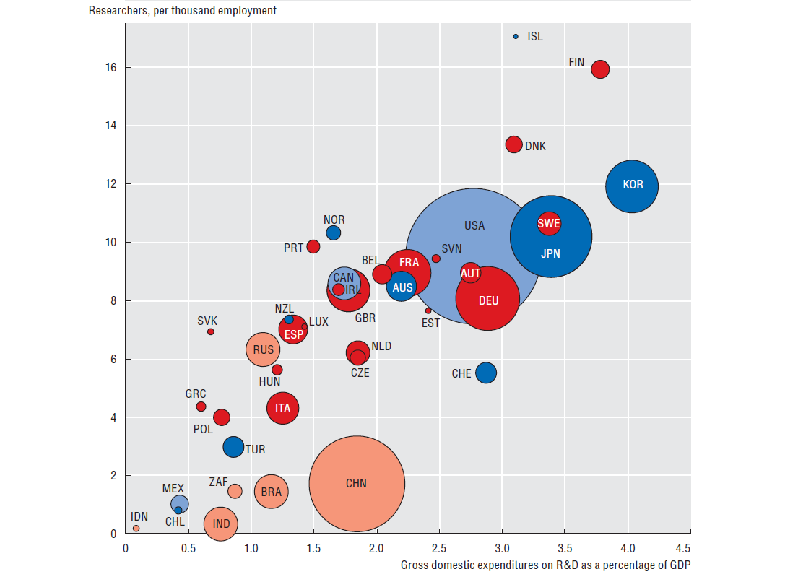

Slide 4
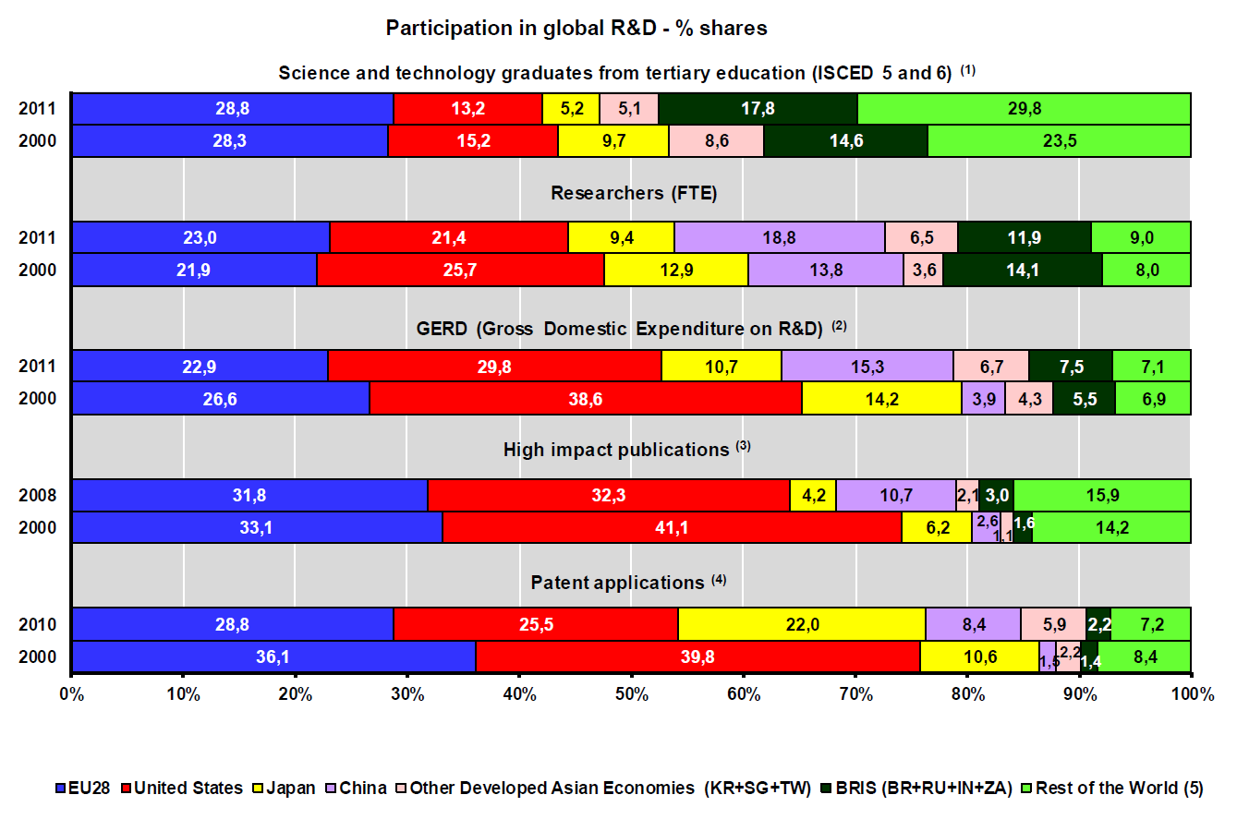
Strengths of European R&I

Slide 5
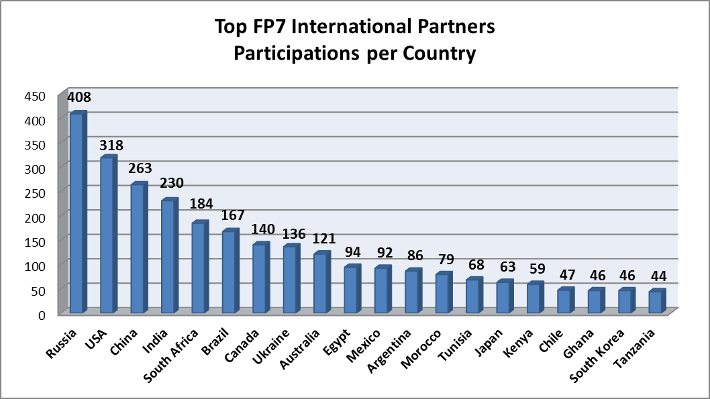
International participation in FP7

Slide 6
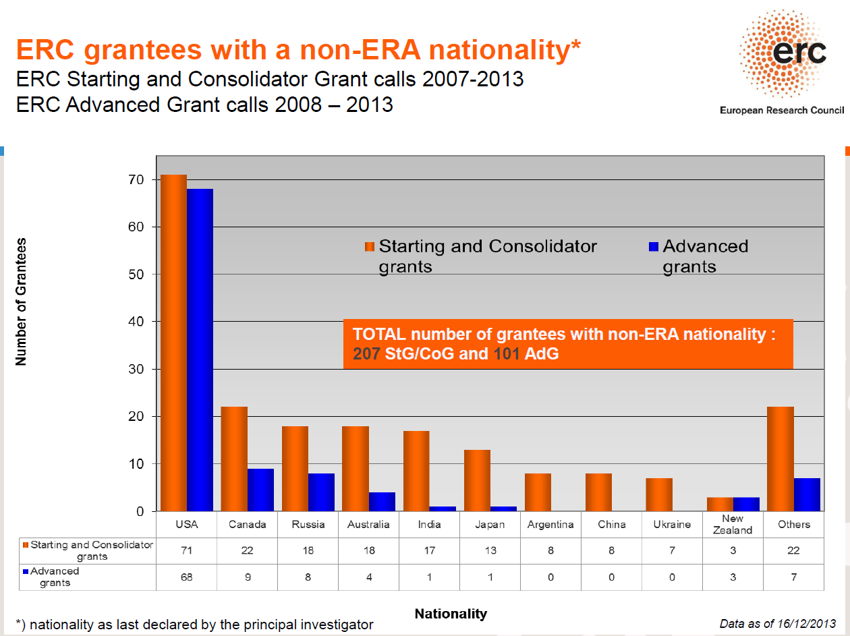
Non-European* ERC grantees in FP7

Slide 7
Indian researchers benefitting from a
Marie Curie grant (by the country of destination)

Slide 8
HORIZON 2020
Excellent Science
Global Challenges
Competitive Industries
Open to the world !

Slide 9
Evolution…
…
FP7
2007-13
H2020
2014-20
…
Collab. pr.
Collab. pr.
MCAs
MSCAs
ERC
ERC
EIT
EIT
CIP
Erasmus Mundus
Erasmus+

Slide 10
What is Horizon 2020?
One of the largest and most open R&I programmes in the world
Funding for research & innovation:
  Collaborative projects for applied research
  European Research Council grants for basic research
  Fellowships supporting the mobility of researchers
  ("Marie Skłodowska-Curie Actions")
Funding available for Sri Lanka partners
(selective funding for emerging countries in collaborative projects)

Slide 11
Three priorities
Excellent science
> 70 bn €
Industrial leadership
Societal challenges

Slide 12
Priority 1
Excellent science
Why:
  World class science is the foundation of tomorrow’s technologies, jobs and wellbeing
  Europe needs to develop, attract and retain research talent
  Researchers need access to the best infrastructures

Slide 13
Funding (€ million, 2014-2020)*
European Research Council (ERC) Frontier research by the best individual teams | 13 095
Future and Emerging Technologies (FETs) Collaborative research to open new fields of innovation (risky, non-conventional, etc.) | 2 696
Marie Skłodowska-Curie actions (MSCA) Opportunities for training and career development | 6 162
Research infrastructures (including e-infrastructure) Ensuring access to world-class facilities | 2 488
All funding figures in this presentation are subject to the pending Multiannual Financial Framework Regulation by the EP and the Council

Slide 14
Priority 2
Industrial leadership
Why:
  Strategic investments in key technologies
  (e.g. advanced manufacturing, micro-electronics) underpin innovation across existing and emerging sectors
  More private investment needs to be attracted in R&I
  More innovative SMEs are needed
  to create growth and jobs

Slide 15
Funding (€ million, 2014-2020)
Leadership in enabling and industrial technologies (LEITs) (ICT, nanotechnologies, materials, biotechnology, manufacturing, space) | 13 557
Access to risk finance Leveraging private finance and venture capital for research and innovation | 2 842
Innovation in SMEs Fostering all forms of innovation in all types of SMEs | 616 + complemented by expected 20% of budget of societal challenges + LEITs and 'Access to risk finance' with strong SME focus

Slide 16
Priority 3
Societal challenges
Why:
  Concerns of citizens and society policy objectives (climate, environment, energy, transport, etc.)
  cannot be achieved without innovation
  Breakthrough solutions come from multi-disciplinary collaborations, including social sciences & humanities
  Promising solutions need to be tested, demonstrated and scaled-up

Slide 17
Funding (€ million, 2014-2020)
1. Health, demographic change and wellbeing | 7 472
2. Food security, sustainable agriculture and forestry, marine and maritime and inland water research and the Bioeconomy | 3 851
3. Secure, clean and efficient energy * | 5 931
4. Smart, green and integrated transport | 6 339
5. Climate action, environment, resource efficiency and raw materials | 3 081
6. Inclusive, innovative and reflective societies | 1 309
7. Secure societies | 1 695
+ Science with and for society | 462
+ Spreading excellence and widening participation | 816
Additional funding for nuclear safety and security from the Euratom Treaty activities (2014-2018)

Slide 18
Simplified Rules for Participation
Simple evaluation criteria
  Excellence – Impact – Implementation (excellence only, for ERC)
One project, one funding rate
  Maximum of 100% of the total eligible costs
  (except for innovation actions: max. 70% for for-profit legal entities)
  Indirect eligible costs: flat rate of 25% of direct eligible costs
Binding deadlines ("time-to-grant", for collab. projects):
  for informing applicants of the outcome of the scientific evaluation of their application: max. five months from the final date for submission of complete proposals;
  for signing grant agreements with applicants or notifying grant decisions to them: max. three months from the date of informing applicants they have been successful.

Slide 19
Horizon 2020 thematic priorities for collaborative projects
Industrial Leadership
Nanotechnologies | Advanced materials
Biotechnology | Advanced manufacturing/proc.
Space | ICTs
Societal Challenges
Health, demographic change and well-being | Climate action, resource efficiency and raw materials
Secure, clean and efficient energy | Inclusive, innovative and reflective societies
Smart, green and integrated transport
Food security, sustainable agriculture, marine and maritime research and the bio-­based economy | Secure societies – protecting freedom and security of Europe and its citizens

Slide 20
A typical Horizon 2020 collaborative project
At least 3 research organisations (public or private) from 3 ≠ European countries
(one of them being the project coordinator)
and possibly more from other countries
(from the EU or not)
4 years duration (example)
10 M€ budget (example)

Slide 21
Typical procedure for collaborative projects
Eur. Commission
Participants
Publication of a
Call for Proposals
Decision to prepare a proposal (find partners)
Evaluation of the proposals (indep. experts)
(excellence/impact/implem.)
Preparation and on-line submission of a proposal
Selection of the best proposals (ranking)
Preparation and signature of the grant agreement
The project can start

Slide 22
How to find partners ?
Scientific and patent literature
Scientific conferences
Cordis Partner Service
(currently 6937 partner profiles and 4694 partnership requests)
Cordis Project Repository (since 1990)
(Catalogue of FP7 projects with Indian participants)
Euraxess Links
National Contact Points
Thematic partner search tools – e.g. the (India-specific) EBTC for clean technologies, http://www.fitforhealth.eu for health / life sciences, etc.

Slide 23
Horizon 2020 mechanisms
2014
2020
Regulation on Horizon 2020 + Rules of participation
WP 2014-2015
Updated WP
Updated WP
…
CfP 1
CfP 2
CfP 3
CfP 4
CfP 5
CfP 6
CfP 7
CfP 8
CfP 9
…
…
…
…
Contract 1
Project 1 running
Contract 2
Project 2
Contract 3
Project 3
Contract X
Project X

Slide 24
Typical Horizon 2020 contract
Commission
Model grant agreement
(terms and conditions)
Technical annex
("Description of the action")
Coordinator
Other annexes
(in particular financial annexes)
Other participants
Accession Forms (for each p.)
Consortium agreement (if any)

Slide 25
ERC Frontier Research grants
Core grants (2-5 years):
  For Principal Investigators (PIs) of any nationality, possibly supported by a team; no pre-determined R&D fields; excellence as sole criterion
  Starting Grants: for researchers with 2-7 years of experience since PhD; max. 1.5 M€ funding
  Consolidator Grants: for rs. with 7-12 yrs of exp.; max. 2 M€
  Advanced Grants: for leading rs. of any age; max. 2.5 M€
Other grants:
  Synergy Grants: for groups made up of 2 to 4 PIs (+ teams);
  max. 15 M€ for 6 years
  Proof of Concept: linked to another ERC grant;
  max. 150.000 €, 18 months

Slide 26
ERC grants (cont'd)
Individual Sri Lanka researchers are eligible
for participation and funding as in FP7
Principal Investigators must:
  spend a minimum 50% of their total working time on the ERC project (30 % for Advanced Grants)
  spend a minimum of 50% of their working time in an EU Member State or Associated Country (Norway, etc.)
Team members may be located anywhere

Slide 27
Marie Skłodowska-Curie Actions (MSCAs)
  No pre-determined R&D fields;
  SL researchers are eligible for participation and funding
  Research networks (ITN): support for Innovative Training Networks
ITNs support competitively selected joint research training and/or doctoral programmes – for early-stage researchers.
  Individual fellowships (IF): support for experienced researchers undertaking mobility between countries, optionally to the non-academic sector
For experienced researchers (PhD or 4 years of relevant experience).
The grant usually covers 2 years.
  International and inter-sectoral cooperation through the Research and Innovation Staff Exchanges (RISE)
RISE support short-term mobility of R&I staff at all career levels, including administrative and technical staff – within and beyond Europe.
  Co-funding of regional, national and international programmes that finance fellowships involving mobility to or from another country (COFUND)

Slide 28
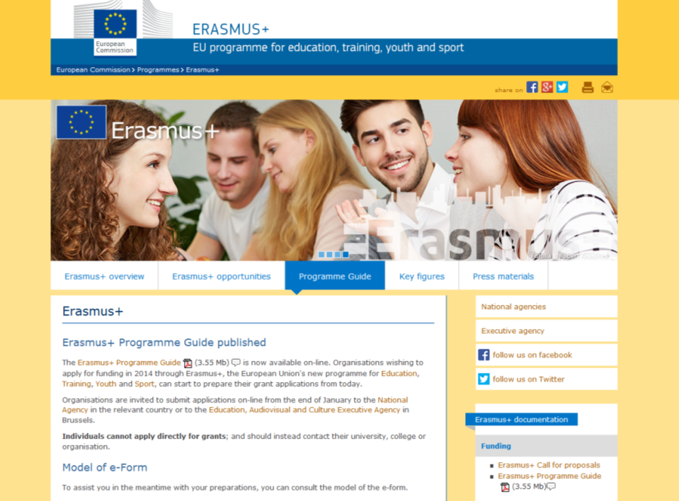
http://ec.europa.eu/programmes/erasmus-plus/

Slide 29
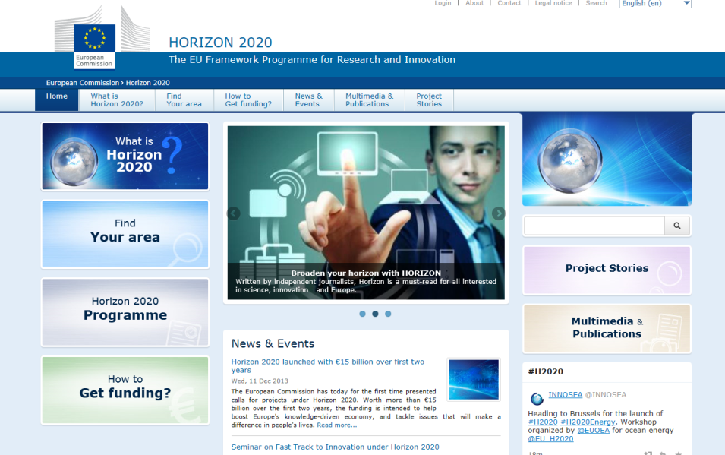
Horizon 2020 website http://ec.europa.eu/programmes/horizon2020/

Slide 30
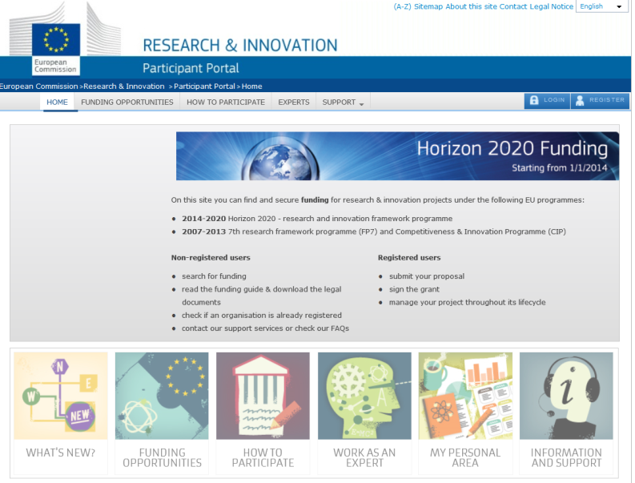
Horizon 2020 Participant Portal http://ec.europa.eu/research/participants/portal/desktop/en/home.html

Slide 31
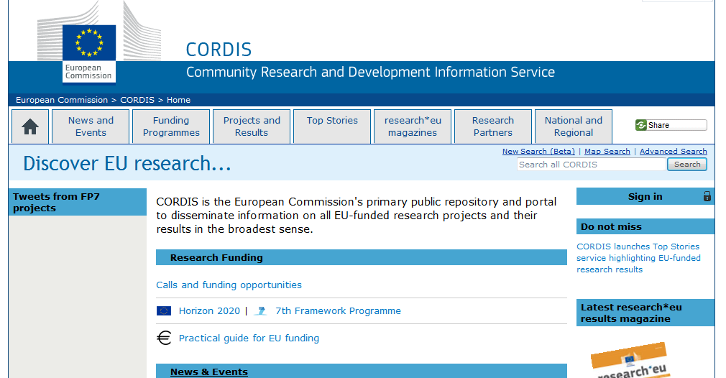
Cordis website
http://cordis.europa.eu/
      search for calls for proposals
      search for partners
      register as an expert to the EU
      subscribe to "RTD info", email alerts, …
      register your research organisation
      find documents, news, project information,…

Slide 32
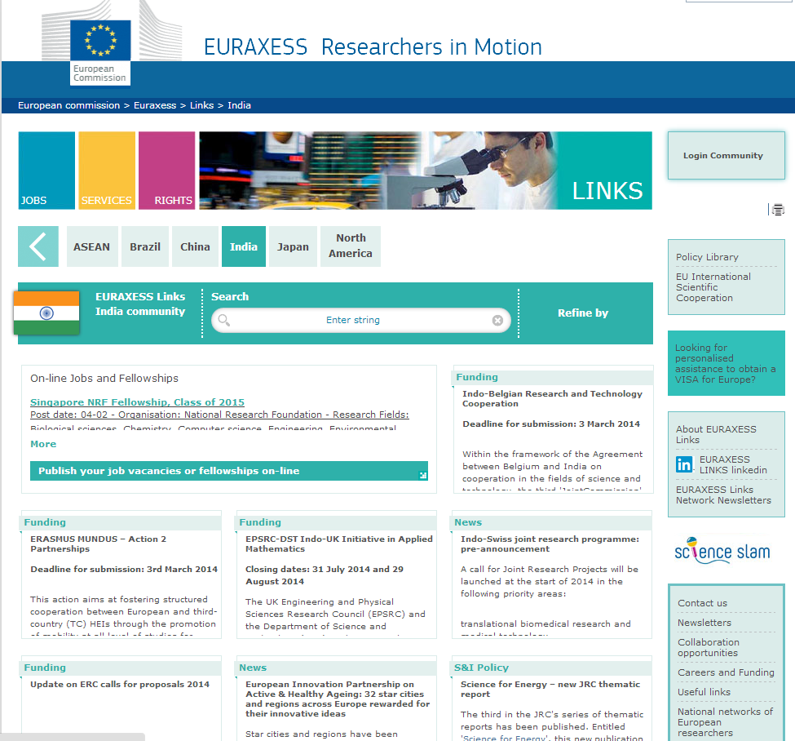

Slide 33
Horizon 2020 Helpdesk
If you have questions about any aspect of European research in general and the EU Research Framework Programmes in particular, send them to the Horizon 2020 Helpdesk.
http://ec.europa.eu/research/index.cfm?pg=enquiries

Slide 34
The CASCADE project
CASCADE: Collaborative Action towards Societal Challenges through Awareness, Development, and Education (FP7)
CASCADE aims to provide the foundation for a future INCONET programme targeting South Asian Countries and which will promote bi-regional coordination of Science & Technology (S&T) cooperation, including priority setting and definition of S&T cooperation policies
CASCADE targets and has the participation of the following South Asian countries: Afghanistan, Bangladesh, Bhutan, Maldives, Nepal, Sri Lanka and Pakistan (University of Engineering & Technology, Peshawar & Local Councils Association of the Punjab)
http://cascade-inconet.eu

Slide 35
Horizon 2020
Wish you success !
For more information
R&I web pages of the
EU Delegation to India:
http://eeas.europa.eu/delegations/india/eu_india/research_innovation

Slide 36
Intellectual property (IPR)
in a R&I context
and in Horizon 2020
in particular

Slide 37
Intellectual property (IP) and R&I
IP:
  Literary & artistic property (copyright, incl. for software)
  Industrial property (patents, trademarks, etc.)
Why is IPR important for researchers ?
  Patent information (huge, free, easy to search)
  Identification of obstacles to exploitation
  Protection of your own results where appropriate
Each R&D result is a (potentially valuable) piece of IP → need for proper management,
and for protection where appropriate (IP rights)

Slide 38
Patent infringement lawsuits/licensing awards
Amount (USD) | Year | Parties | Legal Action | Technology
3,250,000,000 | 2013 | Elan Pharmaceuticals <- Biogen Idec | P. Buyout | Pharmaceutical
2,500,000,000 | 2002 | Major League Baseball <-- Fox Television | C. License | Sports
2,150,000,000 | 2013 | Pfizer <-- Teva and Sun Pharma | P. Settlement | Drug
1,725,000,000 | 1996 | NCAA Basketball <-- CBS | C. License | Sports
1,350,000,000 | 2005 | Karlin Technology <-- Medtronics | P. Settlement | Medical
1,000,000,000 | 2000 | SnapTrack <-- Qualcomm | Buyout | Electronics
890,000,000 | 2012 | Apple <-- Samsung | P. Lawsuit | Software
873,000,000 | 1991 | Polaroid <-- Eastman Kodak | P. Lawsuit | Chemical
820,000,000 | 2001 | Hallmark Entertainment <-- Crown Media | C. Buyout | Miniseries
750,000,000 | 2005 | Medinol <-- Boston Scientific | Contracts/Designs | Medical
700,000,000 | 1997 | Digital <-- Intel | P. Lawsuit | Computer

Slide 39
Patenting
What is patentable: products, processes
(not scientific theories, surgical methods, …)
Basic patentability criteria:
novelty (! disclosures !) + inventive step (non-obviousness)
Several ways to obtain patents:
  File national patent applications (1 patent = 1 country)
  File regional patent applications (e.g. a European patent application, a Eurasian pat. application, …)
  File an international (PCT) patent application
  (procedure to be continued at the nat./reg. level after 30 months)

Slide 40
IP in R&D collaborations
Management of IP at PROs
  Importance of clarifying ownership of results
  Need for general IP awareness (non-disclosure, etc.)
  Need for professional support (TTOs, external firm, …)
  Protect IP to promote exploitation
  (and possibly generate revenues)
Management of IPR in Horizon 2020 projects
  Background: ownership not affected
  Results: belong to the particant(s) generating them
  Access rights:
  to background/results; for R&D/exploitation purposes

Slide 41
Access rights (ARs) under Horizon 2020
 | ARs to bacgkround* | ARs to results
For implementing the project | Royalty-free unless otherwise agreed initially | Royalty-free
For exploitation purposes | Under fair and reasonable conditions
*: Participants shall identify the background for their action in any manner in a written agreement.

Slide 42
IP laws are not the same everywhere…
« Grace period » for patents in the USA, JP, etc.
(→ some disclosures are not detrimental to patentability)
Computer-implemented inventions are not patentable to the same extent in all countries
In some countries:
  need to disclose the origin of biological material involved in a patent application
  patents for pharmaceuticals may be extended up to 25 years
  etc.

Slide 43
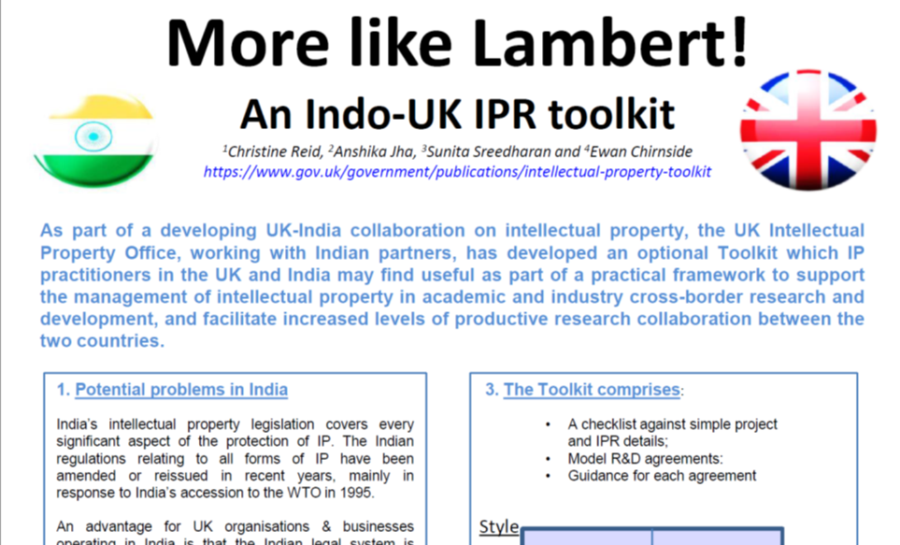

Slide 44
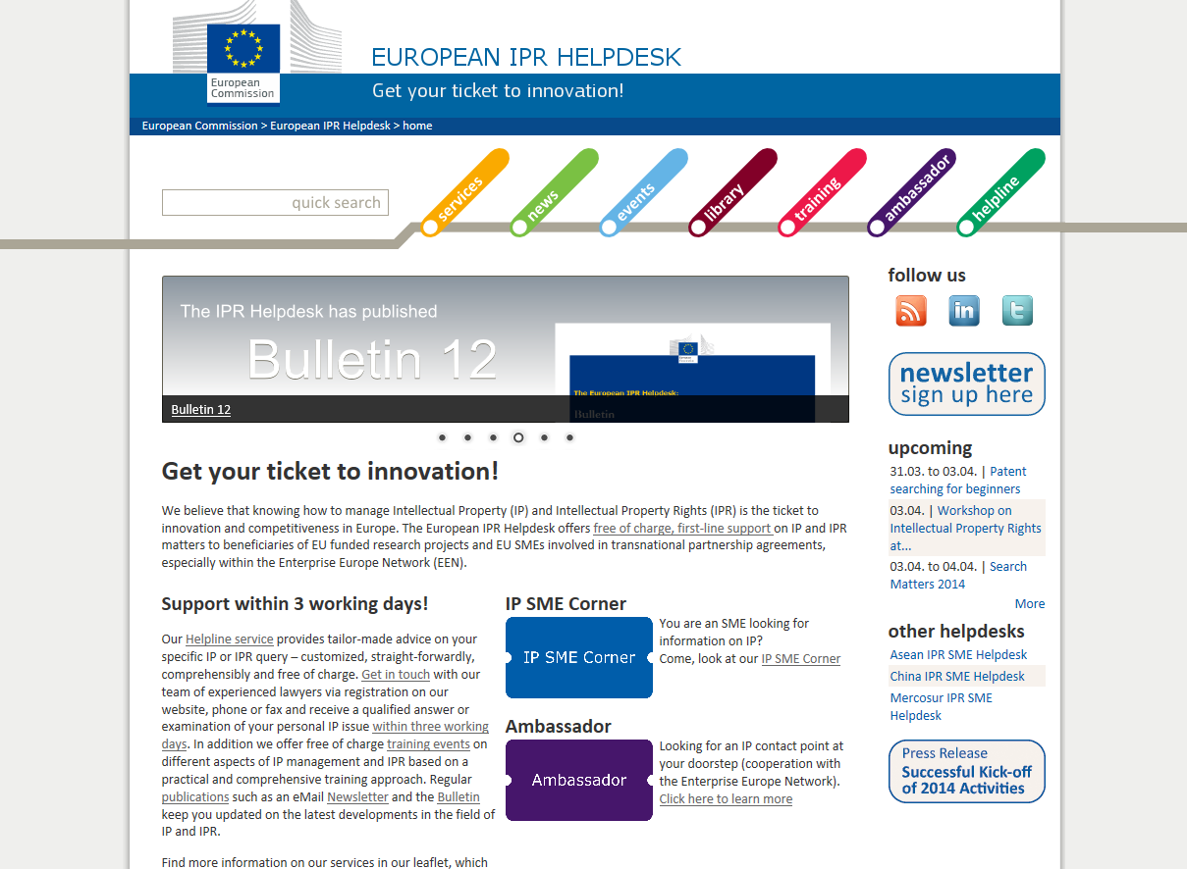
IPR Helpdesk : https://www.iprhelpdesk.eu

Slide 45
Thank you again !

